Slide 1


“Information Security”
Lecture # 6
Dr. Engr. M Malook Rind
Ph.D (I.T), ME (CSN), MBA (MIS), BE (CS)
CCNA, CCNP, Juniper Certified.
Professor (Computer Science)

Slide 2
Contents
Cryptography
Public Key Infrastructure
Cryptographic Protocols
Dr. M Malook Rind Information Security Lecture 6

Slide 3
Cryptography
Dr. M Malook Rind Information Security Lecture 6

Slide 4

What is Cryptography?
Cryptography comes from the Greek words kryptos, meaning “hidden,” and graphein, meaning “to write,” and involves making and using codes to secure messages.
Scrambling information so it cannot be read
Transforms information into secure form so unauthorized persons cannot access it
Cryptography uses mathematical algorithms that are usually known to all.
it’s not the knowledge of the algorithm that protects the encrypted message, it’s the knowledge of the key—a series of characters or bits injected into the algorithm along with the original message to create the encrypted message.
History
Cryptology has an extensive, multicultural history. People have been making, using, and breaking codes for thousands of years, and they will not stop any time soon. Its history starts from 1900 B.C.
Cryptography played role in World War II,
Dr. M Malook Rind Information Security Lecture 6

Slide 5
What is Cryptography?
Steganography
Hides the existence of data
An image, audio, or video file can contain hidden messages embedded in the file
The process of hiding messages; for example, hiding a message within the digital encoding of a picture or graphic so that it is almost impossible to detect that the hidden message even exists.
Here are a few examples:
A hidden message that can be revealed by playing a video at a faster frame rate
Content that can be unveiled by playing an audio track backward
Embedding a message into an RGB image by hiding it in the red, green, or blue channel
Adding noise or sound to encrypt a message within a photo
Hiding content within the file header or metadata
Dr. M Malook Rind Information Security Lecture 6

Slide 6
What is Cryptography? – Key Terms
Encryption is the process of changing original text into a secret message using cryptography
Changing the secret message back to its original form is known as decryption
Plaintext is unencrypted data to be encrypted or is the output of decryption
Ciphertext is the scrambled and unreadable output of encryption
Cleartext data is data stored or transmitted without encryption
Plaintext data is input into a cryptographic algorithm (also called a cipher)
It consists of procedures based on a mathematical formula used to encrypt and decrypt the data
Cryptanalysis is the process of obtaining the plaintext message from a ciphertext message without knowing the keys used to perform the encryption.
Cryptology is the field of science that encompasses cryptography and cryptanalysis.
Dr. M Malook Rind Information Security Lecture 6

Slide 7
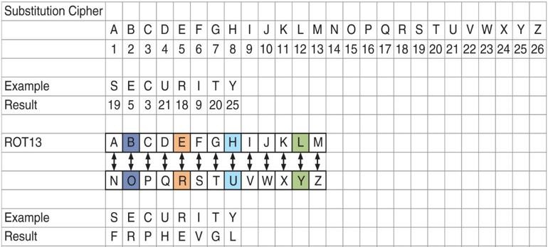
What is Cryptography? - Key
A key is a mathematical value entered into the algorithm to produce ciphertext
The reverse process uses the key to decrypt the message
A substitution cipher substitutes one character for another
One type is a ROT13, in which the entire alphabet is rotated 13 steps (A=N)
Dr. M Malook Rind Information Security Lecture 6

Slide 8
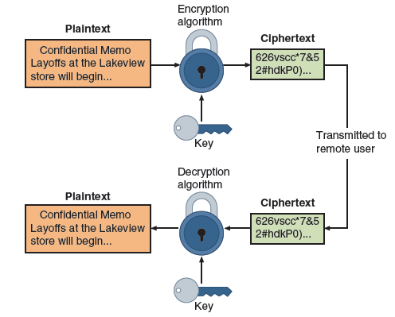
Cryptographic Process
Cryptographic process
Dr. M Malook Rind Information Security Lecture 6

Slide 9
Cryptography Use Cases
Cryptography can provide several basic protections
Confidentiality ensures only authorized parties can view it
Integrity ensures information is correct and unaltered
Authentication ensures sender can be verified through cryptography
Nonrepudiation proves that a user performed an action
Obfuscation is making something obscure or unclear
Security through obscurity
An approach in security where virtually any system can be made secure as long as outsiders are unaware of it or how it functions
Cryptography can provide protection to data as that data resides in any of three states:
Data in processing (also called data in use) is data actions being performed by “endpoint devices”
Data in transit are actions that transmit the data across a network
Data at rest is data that is stored on electronic media
Dr. M Malook Rind Information Security Lecture 6

Slide 10
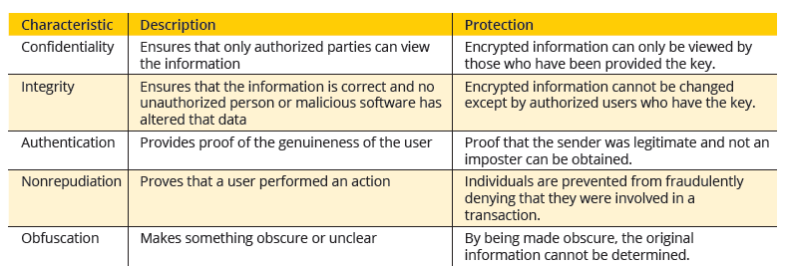
What is Cryptography?
The security protections afforded by cryptography are
Information protections by cryptography
Dr. M Malook Rind Information Security Lecture 6

Slide 11
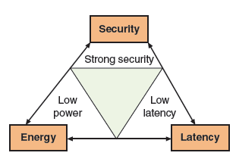
Limitations of Cryptography
Despite providing widespread protections, cryptography faces constraints (limitations) that can impact its effectiveness.
In recent years, the number of small electronic devices that consume little power (low-power devices) has grown significantly.
a cryptographic algorithm should have low latency, or a small amount of time that occurs between when a byte is input into a cryptographic algorithm and the time the output is obtained
Dr. M Malook Rind Information Security Lecture 6

Slide 12
Cryptographic Algorithms
A fundamental difference in cryptographic algorithms is the amount of data processed at a time.
Stream cipher - Stream ciphers convert one symbol of plaintext directly into a symbol of ciphertex.
Stream ciphers encrypt data by generating a stream of random bits, called a keystream, and combining it with the plaintext using a bitwise operation, such as XOR.
Block cipher - encrypt a group of plaintext symbols as one block. The message is divided into blocks—for example, sets of 8-, 16-, 32-, or 64-bit blocks—and then each block of plaintext bits is transformed into an encrypted block of cipher bits using an algorithm and a key.
Sponge function: takes as input a string of any length and returns a string of any requested variable length.
Dr. M Malook Rind Information Security Lecture 6

Slide 13
Cryptographic Algorithms
Three broad categories of cryptographic algorithms
Hash algorithms
Symmetric cryptographic algorithms
Asymmetric cryptographic algorithms
Dr. M Malook Rind Information Security Lecture 6

Slide 14
Cryptographic Algorithms - Hash Algorithms
Hashing is the process of using a mathematical function to convert input data into a fixed-length output. Primarily used for integrity purpose.
Hash algorithm creates a unique “digital fingerprint” of a set of data and is commonly called hashing
This fingerprint, called a digest (sometimes called a message digest or hash), represents the contents
Hashing is a unidirectional process that is impossible to work backwards to retrieve the original data.
The output hash is a fixed-length hexadecimal string of several characters.
An efficient hashing algorithm does not generate the same hash value for two different inputs.
A hashing algorithm is considered secure if it has the following characteristics:
Fixed size - short and long data sets have the same size hash
Unique - two different data sets cannot produce the same hash
Original - not be possible to produce a data set that has a desired or predefined hash
Secure - resulting hash cannot be reversed to determine original plaintext
Dr. M Malook Rind Information Security Lecture 6

Slide 15
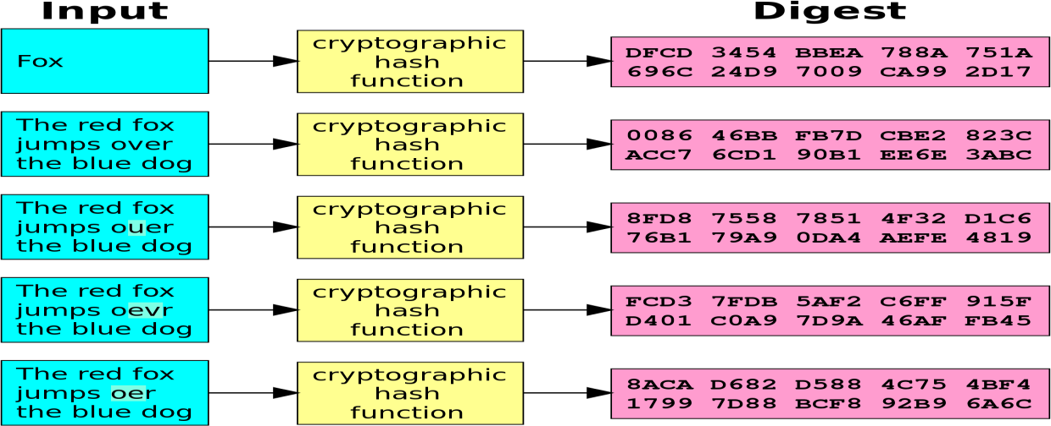
Cryptographic Algorithms - Hash Algorithms
Dr. M Malook Rind Information Security Lecture 6

Slide 16
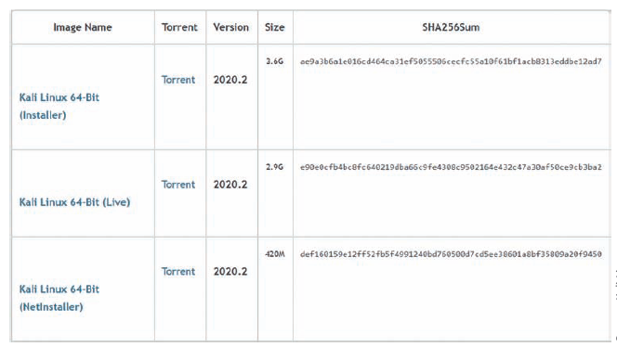
Cryptographic Algorithms - Hash Algorithms
Dr. M Malook Rind Information Security Lecture 6

Slide 17
Cryptographic Algorithms - Hash Algorithms
Common hash algorithms include the following:
• Message Digest (MD). One of the earliest hash algorithms is a “family” of algorithms known as Message Digest (MD). Versions of MD hashes were introduced over almost 20 years, from MD2 (1989) to MD6 (2008). The most widely used of these algorithms is MD5. Serious weaknesses have been identified in MD5, and it is no longer considered suitable for use.
• Secure Hash Algorithm (SHA). Another family of hashes is the Secure Hash Algorithm (SHA). SHA-1 was developed in 1993 but is no longer considered suitable for use. SHA-2 has six variations, the most common are SHA-256, SHA-384, and SHA-512 (the last number indicates the length in bits of the digest that is generated) and is currently considered a secure hash. In 2015, SHA-3 was announced as a new standard.
• RIPEMD. RIPEMD stands for RACE Integrity Primitives Evaluation Message Digest. The primary design feature of RIPEMD is two different and independent parallel chains of computation, the results of which are then combined at the end of the process. All versions of RIPEMD are based on the length of the digest created, including RIPEMD-128, RIPEMD-256, and RIPEMD-320.
Dr. M Malook Rind Information Security Lecture 6

Slide 18
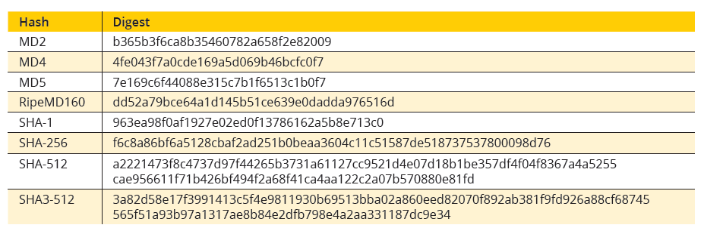
Cryptographic Algorithms - Hash Algorithms
Dr. M Malook Rind Information Security Lecture 6

Slide 19
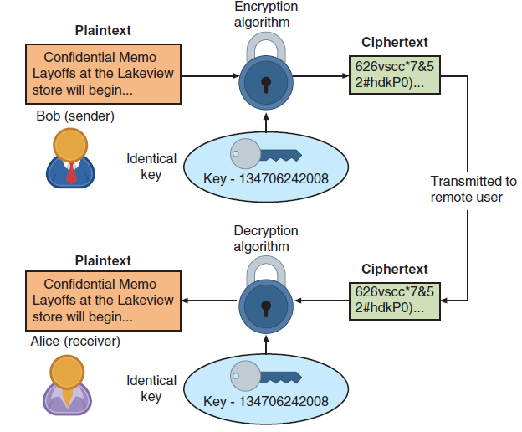
Cryptographic Algorithms - Symmetric Cryptographic Algorithms
Symmetric cryptographic algorithms use the same single key to encrypt and decrypt a document.
Because the key must be kept private (confidential) symmetric encryption is also called private key cryptography (the key is kept private between sender and receiver).
Symmetric cryptography can provide strong encryption—if the key is kept secure between the sender and all the recipients
Symmetric cryptographic algorithms are:
Data Encryption Standard (DES)
Triple Data Encryption Standard (3DES)
Advanced Encryption Standard (AES)
Rivest Cipher (RC)
Blowfish
Dr. M Malook Rind Information Security Lecture 6

Slide 20
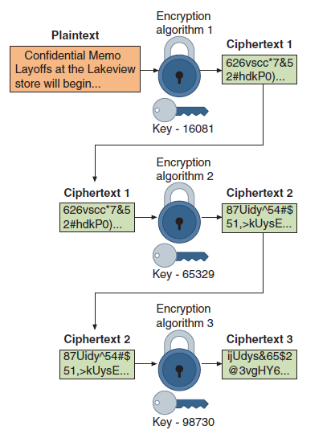
Cryptographic Algorithms - Symmetric Cryptographic Algorithms
Common algorithms include:
Data Encryption Standard (DES): One of the first widely used symmetric cryptography algorithms. Was once adopted by U.S Government. But now it is no longer considered suitable for use.
Triple Data Encryption Standard (3DES): was designed to replace DES. As its name implies, 3DES uses three rounds of encryption instead of just one. The ciphertext of one round becomes the entire input for the second iteration. 3DES employs a total of 48 iterations in its encryption (3 iterations X 16 rounds).
Advanced Encryption Standard (AES): U.S (NIST) introduced in 2001. AES is widely used today as it is a much stronger than DES and triple DES despite being harder to implement. The key size can be 128/192/256 bits. Encrypts data in blocks of 128 bits each.
Rivest Cipher (RC): is a family of six algorithms. RC4, the most common RC cipher, is a stream cipher that accepts keys up to 128 bits in length.
Blowfish: is a block cipher algorithm that operates on 64-bit blocks and can have a key length from 32 to 448 bits. To date, no significant weaknesses have been identified.
Dr. M Malook Rind Information Security Lecture 6

Slide 21
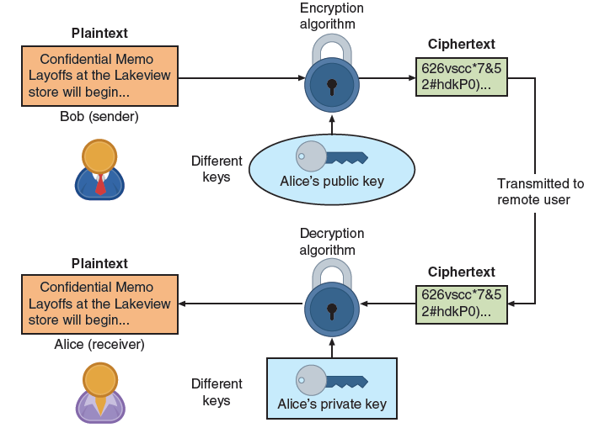
Cryptographic Algorithms - Asymmetric Cryptographic Algorithms
The primary weakness of symmetric algorithms: distributing (Exchange) and maintaining a secure single key among multiple users distributed geographically poses challenges.
Asymmetric cryptographic algorithms use two mathematically related keys (known as the public key and the private key)
Also known as public key cryptography
Public key available to everyone and freely distributed
Private key known only to individual to whom it belongs
When Bob wants to send a secure message to Alice, he uses Alice’s public key to encrypt the message. Alice then uses her private key to decrypt it
Dr. M Malook Rind Information Security Lecture 6

Slide 22
Cryptographic Algorithms - Asymmetric Cryptographic Algorithms
Several important principles regarding asymmetric cryptography are as follows:
Key pairs : Unlike symmetric cryptography that uses only one key, asymmetric cryptography requires a pair of keys.
Public key: Public keys, by their nature, are designed to be public and do not need to be protected. They can be freely given to anyone or even posted on the Internet.
Private key: The private key must be kept confidential and never shared.
Both directions - keys can work in both directions. A document encrypted with a public key can be decrypted with the corresponding private key. In the same way, a document encrypted with a private key can be decrypted with its public key.
Dr. M Malook Rind Information Security Lecture 6

Slide 23
Cryptographic Algorithms - Asymmetric Cryptographic Algorithms
Digital Signature Algorithm (DSA)
A digital signature is an electronic, encrypted, stamp of authentication on digital information such as email messages, macros, or electronic documents.
A valid digital signature on a message gives a recipient confidence that the message came from a sender known to the recipient.
A digital signature can:
• Verify the sender. A digital signature serves to confirm the identity of the person from whom the electronic message originated.
• Prevent the sender from disowning the message. The signer cannot later attempt to disown it by claiming the signature was forged (nonrepudiation).
• Prove the integrity of the message. A digital signature can prove that the message has not been altered since it was signed.
Dr. M Malook Rind Information Security Lecture 6

Slide 24
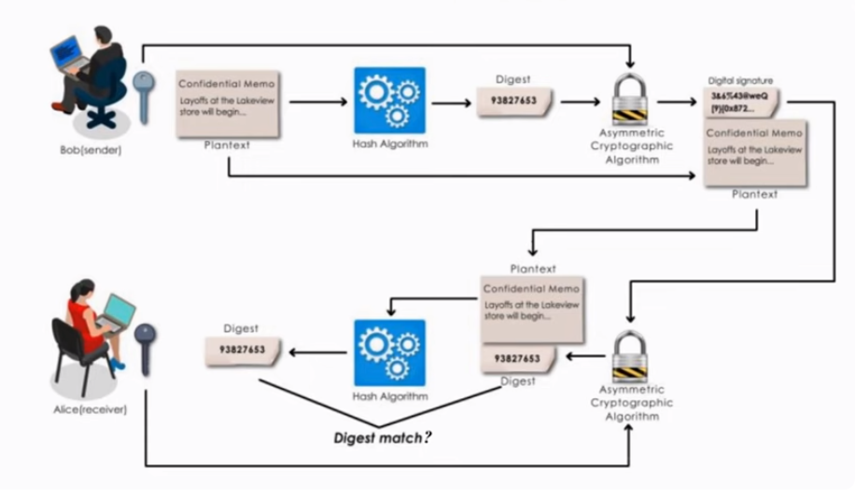
Cryptographic Algorithms - Asymmetric Cryptographic Algorithms
The steps for Bob to send a digitally signed message to Alice are as follows:
1. After creating a memo, Bob generates a digest on it.
2. Bob encrypts the digest with his private key. The encrypted digest is the digital signature for the memo.
3. Bob sends both the memo and the digital signature to Alice.
4. When Alice receives them, she decrypts the digital signature using Bob’s public key, revealing the digest. If she cannot decrypt the digital signature, then she knows that it did not come from Bob (because only Bob’s public key can decrypt the digest generated with his private key).
5. Alice then hashes the memo with the same hash algorithm Bob used and compares the result to the digest she received from Bob. If they are equal, Alice can be confident that the message has not changed since he signed it. If the digests are not equal, Alice will know the message has changed since it was signed.
Dr. M Malook Rind Information Security Lecture 6

Slide 25
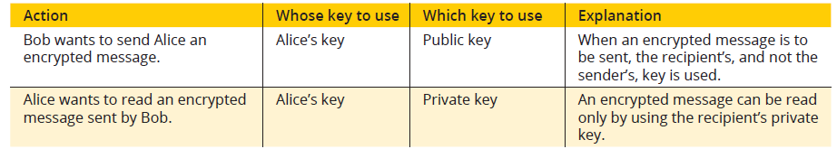
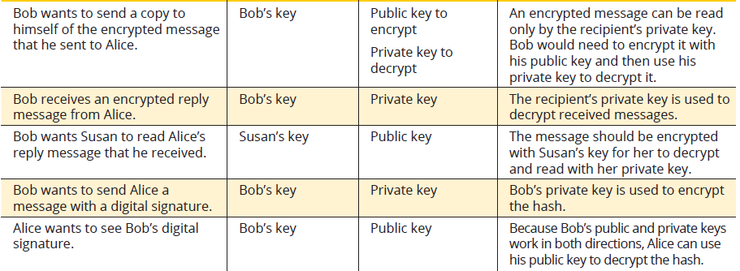
Cryptographic Algorithms - Asymmetric Cryptographic Algorithms
Dr. M Malook Rind Information Security Lecture 6

Slide 26
Cryptographic Attacks
Cryptography remains under attack by threat actors for any vulnerabilities
Two of the most common cryptography attacks are algorithm attacks and collision attacks
Algorithm Attacks
Very few threat actors have the advanced skills needed to even attempt to break an algorithm.
Methods attackers can use to circumvent strong algorithms:
Known ciphertext attacks
Cryptography prevents threat actors from knowing the plaintext or the key.
The only item they can see is the ciphertext itself.
Statistical tools can be used to attempt to discover a pattern in the ciphertexts, which can then be used to reveal the plaintext or key
Downgrade Attack
An attacker forces the system to abandon the current higher security mode of operation and instead “fall back” to implementing an older and less secure mode. The threat actor can then attack the weaker mode
Attacks Based on Misconfigurations
Result of incorrect choices or misconfigurations of the cryptography options.
Collision Attacks
When two files have the same digest this is known as a collision.
attacker could infiltrate a website and post a malicious file for download, but when the digest was generated for the malicious file, it created the same digest as the one posted for the legitimate file.
Dr. M Malook Rind Information Security Lecture 6

Slide 27
Using Cryptography
Cryptography can be applied through either:
Software
Hardware.
A relatively new technology known as blockchain uses cryptography as its basis.
Dr. M Malook Rind Information Security Lecture 6

Slide 28
Using Cryptography - Encryption through Software
File and File System Cryptography
Encryption software can be used to encrypt or decrypt files one-by-one (a cumbersome process)
Protecting groups of files can take advantage of the OS’s file system
Third-party software tools available for encryption include GNU Privacy Guard (GNuPG), AxCrypt, Folder Lock, and VeraCrypt
Operating System Encryption
Microsoft Windows Encrypting File System (EFS) is a cryptography system for Windows
EFS uses NTFS file system.
Any file created in an encrypted folder or added to an encrypted folder is automatically encrypted.
Full Disk Encryption (FDE)
FDE protects all data on a hard drive
Example: BitLocker drive encryption software that is included in Microsoft Windows
BitLocker encrypts the entire system volume, including the Windows Registry
Prevents attackers from accessing data by booting from another OS or placing the hard drive in another computer
Dr. M Malook Rind Information Security Lecture 6

Slide 29
Using Cryptography - Blockchain
A blockchain is a shared, immutable ledger that facilitates the process of recording transactions and tracking assets in a business network
Blockchain technology allows a network of computers to agree at regular intervals on the true state of a distributed ledger
It is a system in which a record of transactions made is maintained across several computers that are linked in a peer-to-peer network
Blockchain relies on cryptographic hash algorithms to records its transactions
Dr. M Malook Rind Information Security Lecture 6

Slide 30
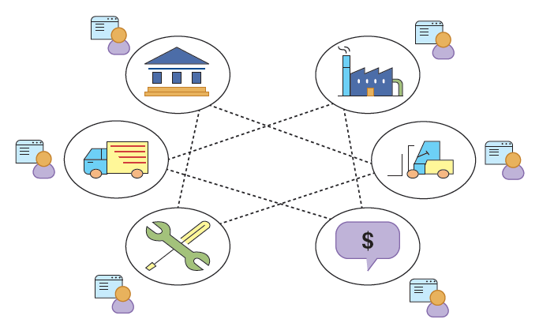
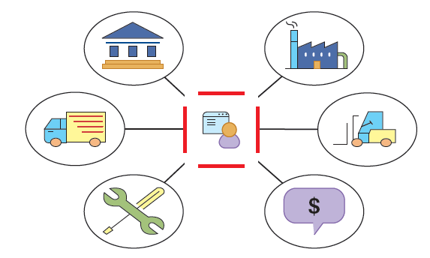
Using Cryptography - Blockchain
Multiple organizations with ledgers
Multiple organizations using single ledger
Dr. M Malook Rind Information Security Lecture 6

Slide 31
Thanks
Dr. M Malook Rind Information Security Lecture 6

